Slide 1
AFMR PPT 3
TRIAL BALANCE

Slide 2
A trial balance is a bookkeeping worksheet in which the balance of all ledgers are compiled into debit and credit account column totals that are equal. A company prepares a trial balance periodically, usually at the end of every reporting period.
The trial balance has two sides, the debit side and the credit side. Debits include accounts such as asset accounts and expense accounts. Credits are accounts such as income, equity and liabilities. ... The debit side and the credit side must balance, meaning the value of the debits should equal the value of the credits.

Slide 3
RULES OF TRIAL BALANCE
All assets must be put on the debit side.
All liabilities must be put on the credit side.
All Capital must be put on the credit side
All revenue must be recorded on the credit side.
All expenses must be recorded on the debit side.

Slide 4
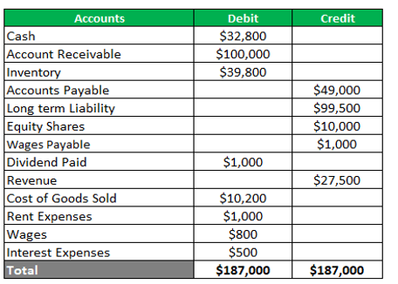
Trial Balance Format
Trial Balance of ABC as on 31st March

Slide 5
From the following information make a trial Balance and find Capital amount:
(Figs in Rs) Sales: 4,00,000, Purchases: 5,00,000, Sales Return 20,000, Purchase Return 15,000, Wages 20,000, Carriage inward 28000, Commission Received 16000, Discount Allowed 12000, Cash 45,000, Bank 24,000, Furniture 16,000 .

